Slide 1
Crop-Aware Panoptic Segmentation
Mehdi Naouar, Ben Bausch, Yannick Vogt

Slide 2
The Most Important Rules
Use only TeXPoint for formulas
Set your Language to English (US)
Spell your slides (press F7)
Videos should be
MP4 with H.264 standard settings or
MS RLE encoding for animations
Use MS Office 2010/2011 and not OpenOffice and friends

Slide 3
Other Important Rules
Set TexPoint resolution to 600 dpi
To include eps images, use the \includegraphics command in TeXPoint
The font is always Verdana
Do not use a line spacing below 1
Do not use page numbers or other footers on slides
Font embedding: Tools-Options-Save- Embed TT fonts->Embed all chars

Slide 4
Colors & Shapes
Blue has a RGB value of: 51, 102, 153
Red has a RGB value: 154, 0, 0
Some good example shapes are

Slide 5
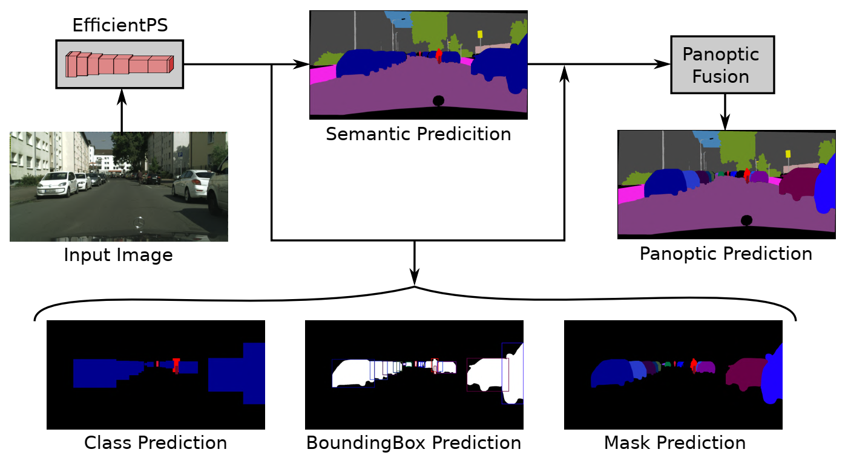
Motivation
Notes:
What is Panoptic Segmentation?
Whats the goal?
Rohits Paper

Slide 6
Our Task
What is Cabb?

Slide 7
Visualization of Cabb
Target vs cabb target
Maybe hardcode a prediction that imagines a larger prediction and show how cabb behaves and what the loss is

Slide 8
Results/Comparison
Final values
Graph with history?
Training speed difference(look when episode saves were created)!

Slide 9
Thank you for your attention!

